Slide 1
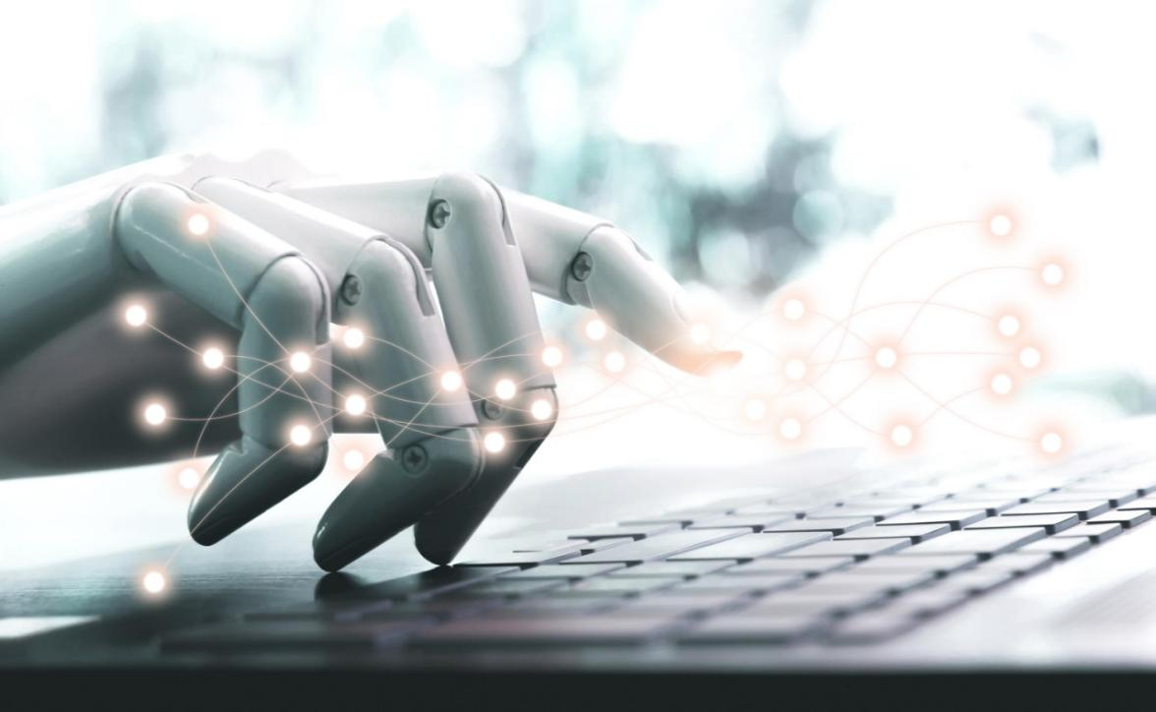
Plagiarism Detector
AI AGENT

Slide 2
GROUP NO.6 MEMBERS
MIS No. | Name
242262007 | Aditi Kandarkar
242262012 | Prerana Nimhan
242262017 | Vaishnavi Tale

Slide 3
Ai Agent
Plagiarism DETECTOR is a 'learning based Agent' which Takes it's BASIC knowledge from the reference documents.

Slide 4
What is the Plagiarism
Plagiarism is an unethical use of content, yet people still do it.
All information sources require a citation, whether in an academic or professional atmosphere. Missing citations lead to plagiarism, or the uncredited use of another person's content (words or otherwise).
While some people may be skilled at identifying plagiarized text with the naked eye, AI-powered platforms can provide multiple tools for making content readable, impactful, and grammatically correct. Software as a service (SaaS) is used as a platform for users to check their documents for plagiarism.

Slide 5
The role of AI in plagiarism detection
Similar to many other booming fields, artificial intelligence has been implemented to tackle the problem of plagiarism.AI takes on a vital role in this regard because stolen content often gets modified to a great degree in order to evade even the strongest copy content scanning software.
There are savvy text-modification tools some people use to evade plagiarism detection. Thus, AI-powered plagiarism detection is the best method for accuracy. Plagiarism has developed into a menace, and committing plagiarism has become very easy. To eliminate plagiarized content from online archives and to promote a plagiarism-free environment, highly intelligent software systems have been developed to halt the growth of plagiarism.

Slide 6
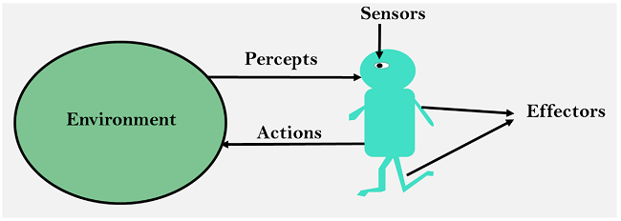
PEAS TASK DESCRIPTION
Performance Measure :-
Accuracy Rate - number of correctly identified instances of plagiarism or duplication.
Scanning Time
Verification Time
Environment :-
Digital documents, which can be accessed and analyzed by the system.

Slide 7
PEAS TASK DESCRIPTION
Actuators :-
Algorithms to compare documents,
Machine learning models to detect patterns,
Database to store and access reference documents.
Eg. generate a report or block the content by removing it from website
Sensors :-
Document Scanner an OCR(Optical Character Recognition)
Comparison Algorithms
natural language processing (NLP)
A plagiarism checker may use reference databases to feedback mechanisms to assess the accuracy techniques that detect similarities in syntax, vocabulary, or sentence structure. compare documents with existing sources of its plagiarism detection.

Slide 8
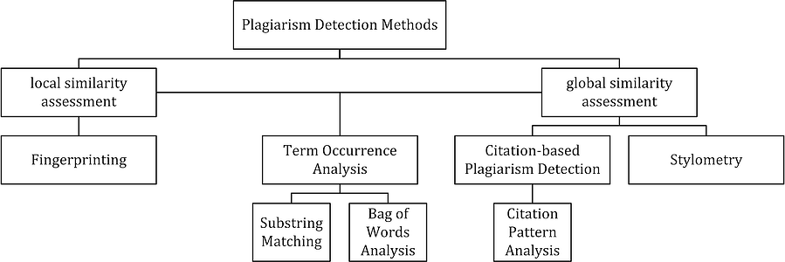
Working
Different algorithms are used to prevent duplicate content

Slide 9
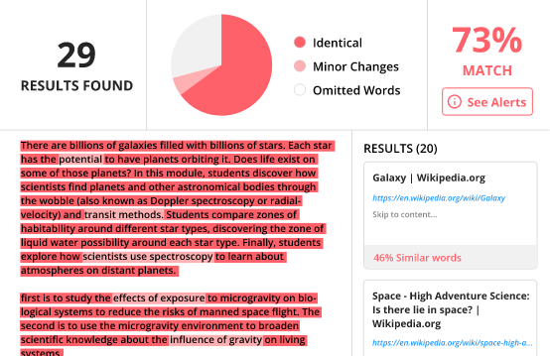
Applications:-
Content producers, bloggers, editors, publishers, authors, freelancers, and educators can all gain advantages from plagiarism detectors.
Editors can examine a piece of writing submitted and determine whether it is original or copied, and they can use detectors to check if someone has stolen their work and is exploiting it

Slide 10
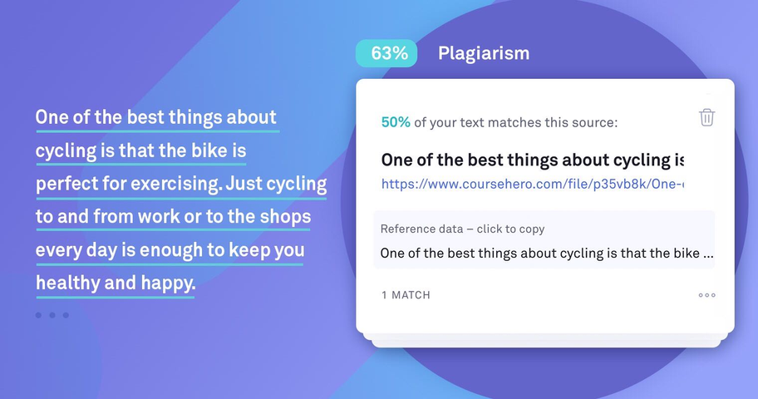
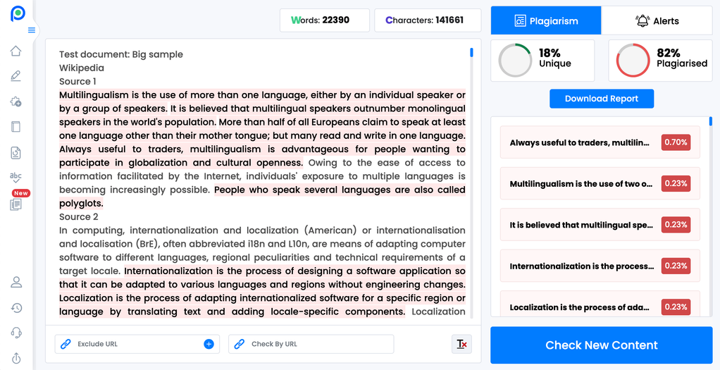
Grammarly
Scribbr

Slide 11
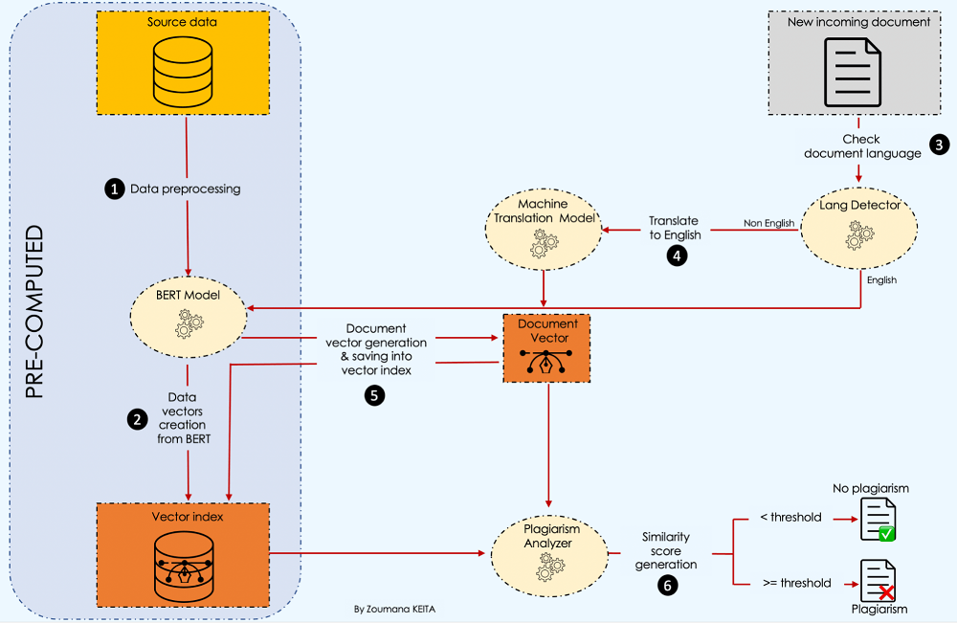

Slide 12


